Slide 1

Dsci 560: Group 15

Slide 2


Slide 3



Investment Update
47%
Spent working with portfolio
Board Materials
others
others
others
Ad-hoc Reports
One VC Investor
31%
Spent time for Deal Sourcing
Avg 9.9
Startsups
Avg 20-40
Documents Yearly

Slide 4
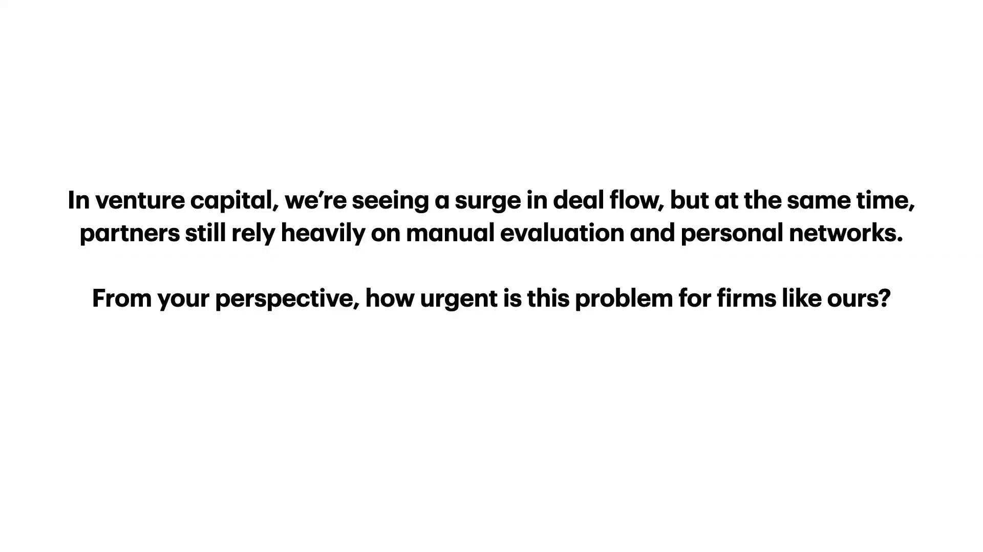

Slide 5

How repetitive is document handling in your day-to-day work?

Slide 6
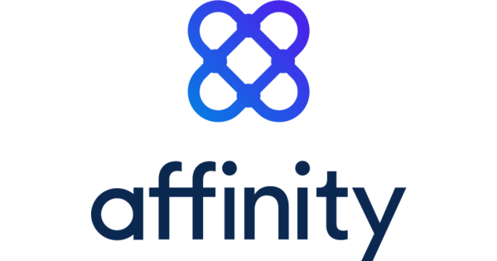
Relationship Graph Based
File Storage Based
X
Deal Sourcing
Portfolio Managing
Risk Detection
Direct Market Size: $ 2B (Est.)

Slide 7
External RAG
(Web, News, Market Data)
AI Semantic Understanding
AI Based Risk Analysis
Deal Sourcing
Portfolio Managing
Risk Detection
Affinity CRM $ 2B (Est.) +
Market Intelligence $ 3B +
Risk Management $ 5B
= $ 10 B

Slide 8



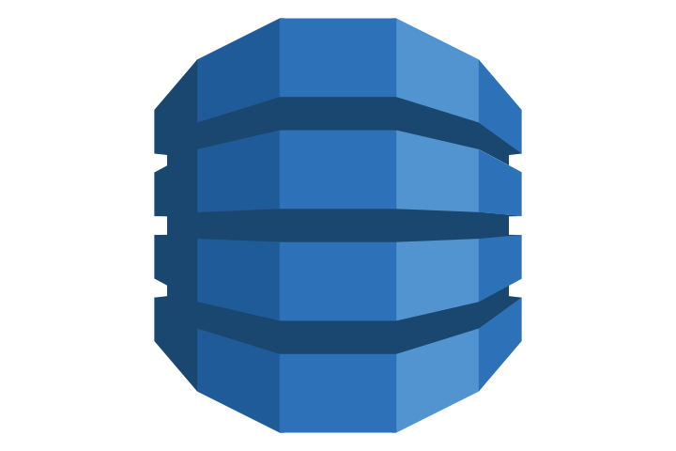

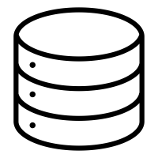




Portfolio Managing
Query
Answer
AWS DynamoDB
SnowFlake: snowflake-arctic-embed-l-v2.0
Vector RAG + MEM0
Store Vector Embedding

Slide 9
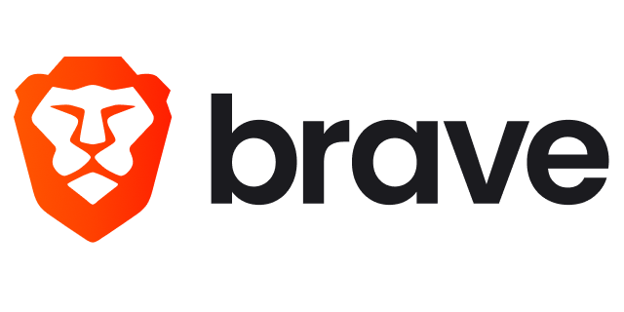
Deal Sourcing & Risk Detection
Deal Sourcing & Risk Alerts
AWS DynamoDB
SnowFlake: snowflake-arctic-embed-l-v2.0
Brave Search MCP Server
Vector RAG + External RAG

Slide 10
References
[1] Taj, Hurratul Maleka. 2025. “How Do Venture Capitalists Make Decisions? by Paul Gompers, William Gornall, Steven Kaplan, and Ilya A. Strebulaev: An In-Depth Review.” LinkedIn. Read article
[2] Affinity. 2026. “Affinity – CRM for Private Capital and Relationship Intelligence Platform.” Accessed April 2026. https://www.affinity.co/
[3] Market Research Future. 2026. “Venture Capital Market Size, Share, and Forecast Report to 2035.” Last updated April 6, 2026.
https://www.marketresearchfuture.com/reports/venture-capital-market-24699

Slide 11
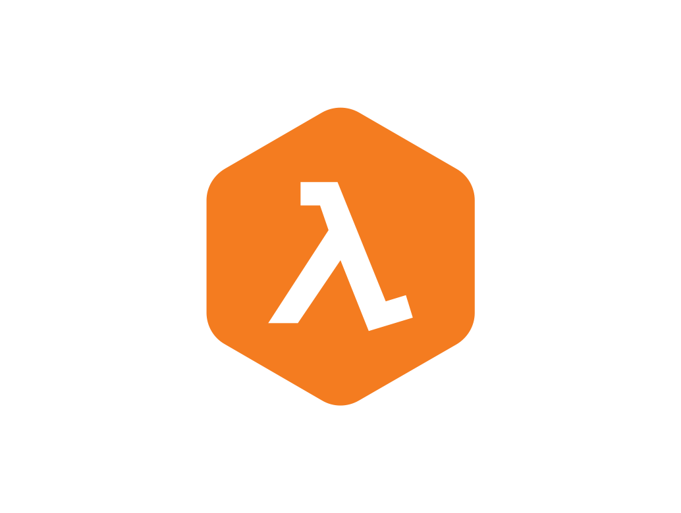
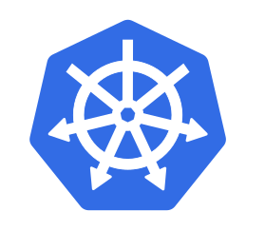
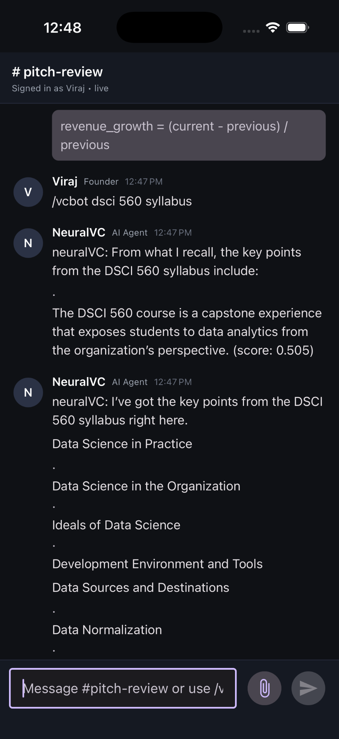
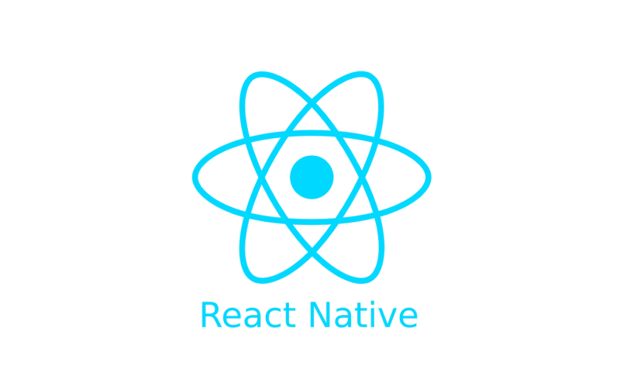
AWS Lambda
AWS Gateway API
AWS DynamoDB
Group Chat
AI Private Chat
AI Group Chat
File Upload
Maintain Websocket Session
Route Requests to Lambda
Session Data
Store Chat History
React Native
Frontend

